Slide 1
Unit 2
Using the System

Slide 2
Unit Objectives
After completing this unit, you should be able to:
Log in and out of the system
State the structure of AIX commands
Execute basic AIX commands
Use AIX commands to communicate with other users

Slide 3
Logging In and Out
To Log in:
To Log out:
login: team01
team01's Password: (the password does not appear)
$
$ <Ctrl-d> (or)
$ exit (or)
$ logout
login:

Slide 4
Passwords
Creating or Changing:
$ passwd
Changing password for "team01"
team01's Old password:
team01's New password:
Enter the new password again:
$

Slide 5
Command Format
AIX commands have the following format:
  $ command option(s) argument(s)
$ ls
$ ls –l
$ ls /dev
$ ls –l /dev

Slide 6
Command Format Examples
WRONG:
1. Separation:
$ mail - f newmail
$ who-u
2. Order:
$ mail newmail -f
$ team01 mail
$ -u who
3. Multiple Options:
$ who -m-u
$ who -m u
4. Multiple Arguments:
$ mail team01team02
RIGHT:
1. Separation:
$ mail -f newmail
$ who -u
2. Order:
$ mail -f newmail
$ mail team01
$ who -u
3. Multiple Options:
$ who -m -u
$ who -mu
4. Multiple Arguments:
$ mail team01 team02
THERE ARE EXCEPTIONS!!

Slide 7
The date and cal Commands
Checking the date:
Looking at a month:
Looking at a year:
$ date
Wed Nov 14 10:15:00 GMT 2007
$
$ cal 1 2003
  January 2003
Sun Mon Tue Wed Thu Fri Sat
1 2 3 4
5 6 7 8 9 10 11
12 13 14 15 16 17 18
19 20 21 22 23 24 25
26 27 28 29 30 31
$ cal 2007

Slide 8
The clear, echo, and banner Commands
clear: Clears the terminal screen
echo: Writes what follows to the screen
banner: Writes character strings in large letters to the screen
$ clear
  $ echo Lunch is at 12:00
  Lunch is at 12:00
$
$ banner Hello

Slide 9
Activity: Questions and Answers
What's wrong with the following commands?
$ du -s k _______________________________
$ df-k _______________________________
$ du -a-k _______________________________
Which command ...
... changes your password? _____________
... clears the screen? _____________
... prints out the current system date? _____________
... exits the current shell? _____________

Slide 10
The who and finger Commands
Finding who is on the system:
Finding who you are:
Displaying information about the users currently logged on:
$ who
  root lft0 Sept 4 14:29
  team01 pts/0 Sept 4 17:21
  $ who am i
  team01 pts/0 Sept 4 17:21
  $ whoami
  team01
  $ finger team02
  Login name: team02
  Directory: /home/team02 Shell: /usr/bin/ksh
  On since Mar 04 16:17:10 on tty3
  No Plan.

Slide 11
Sending Mail
$ mail team01
Subject: Meeting
There will be a brief announcement meeting today
in room 602 at noon.
<Ctrl-d>
Cc: <Enter>
$
$ mail team20@sys2
Subject: Don't Forget!
Don't forget about the meeting today!
<Ctrl-d>
Cc: <Enter>
$

Slide 12
Receiving Mail
[YOU HAVE NEW MAIL]
$ mail
Mail [5.2 UCB] [AIX5.X] Type ? for help
"/var/spool/mail/team01": 2 messages 1 new
U 1 team05 Tue Jan 7 10:50 10/267 "Hello !"
>N 2 team02 Wed Jan 8 11:25 16/311 "Meeting"
? t 2
From team02 Wed Jan 8 11:25 2003
Date: Wed 8 Jan 2003 11:25
From: team02
To: team01
Subject: Meeting
Cc:
There will be a brief announcement meeting today in room 602 at noon.
? d (Delete message)
? q (Quit mail command)

Slide 13
The write and wall Commands
Send messages to other users on a system
  write provides conversation-like communication with another logged-in user. Each user alternatively sends and receives messages.
  The wall command writes to all terminals. This is useful to notify all users of a system event:
$ write team01 (or)
$ write sarah@moon
$ wall The system will be inactive from 10pm today.
Broadcast message from team01@sys1 (pts/1) at 15:11:58
The system will be inactive from 10pm today.
$

Slide 14
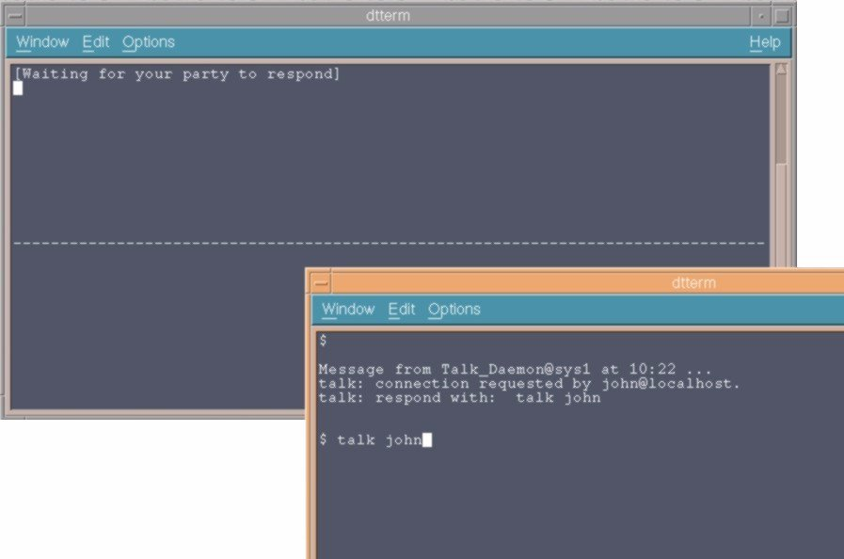
talk with Another User
$ talk fred (user john requests the connection)
(to accept the invitation fred enters:)

Slide 15
mesg
The mesg command controls whether other users on the system can send messages to you:
team01$ mesg
The current status is y.
team01$ mesg n
team01$
team02$ write team01
write: 0803-031 Permission denied.
team02$

Slide 16
Keyboard Tips
<Backspace>
<Ctrl-c>
<Ctrl-d>
<Ctrl-s>
<Ctrl-q>
<Ctrl-u>
Corrects mistakes
Terminates the current
command and returns to the
shell
End of transmission or end
of file
Temporarily stops output to
the screen
Resumes output (stopped by Ctrl-s)
Erases the entire line

Slide 17
Checkpoint
What is the correct command syntax in AIX?
  $ mail newmail –f
  $ mail f newmail
  $ -f mail
  $ mail -f newmail
What command would you use to send mail items?
What are other commands that can be used to communicate with other users?
What output would you expect from the following command: cal 8?
Which command would you use to find out when a particular user logged in?
  $ who am i
  $ who
  $ finger everyone
  $ finger username

Slide 18
Checkpoint Solutions
What is the correct command syntax in AIX?
  $ mail newmail –f
  $ mail f newmail
  $ -f mail
  $ mail -f newmail
What command would you use to send mail items? mail username
What are other commands that can be used to communicate with other users? talk, write, and wall
What output would you expect from the following command: cal 8? The calendar for the year 8 AD
Which command would you use to find out when a particular user logged in?
  $ who am i
  $ who
  $ finger everyone
  $ finger username

Slide 19

Exercise: Using The System

Slide 20
Unit Summary
AIX commands can use multiple options and arguments and must follow proper syntax rules.
There are many simple, yet powerful commands such as:
date
cal
who, who am I
finger
echo
clear
banner
Communicate with other UNIX users using commands such as: mail, write, talk, and wall.

